Slide 1







StreamVerse Media Consultation
Presented by:
Ali Hasan
Seddiqa Shubbar
Zainab Alghadhban

Slide 2



WHO WE ARE?
We are a data analytics consultancy
Working with InsightEdge Analytics, specializing in strategic, data-driven solutions for media companies
Our Mission
Empowering media business with actionable insights to enhance performance and drive smarter decisions

Slide 3

Agenda
Introduction
Problem Statement
Aim
Objectives
Analysis
Recommendations
Conclusion

Slide 4






Introduction
StreamVerse Media is a fast-growing platform that owns and operates a leading
Market Highlight
  Netflix leads with 300M+ subscribers and $39B revenue.
  Hulu and HBO Max have large audiences, but regional content limitations reduce accessibility.

Slide 5
Problem Statement
StreamVerse Media offers millions of streaming options, is facing reduced user engagement due to content overload and limited variety, with 82% of its library content being movies. This imbalance may negatively affect its revenue and brand reputation.

Slide 6

Aim
To provide actionable insights into the key factors that highlight each platform's strengths, content variety, overlap, and freshness, and to offer clear strategies to enhance performance and drive growth.

Slide 7

Objectives
01
Understanding Content Variety
How well each platform diversifies its content by type and genre?
02
Highlighting Content overlap and Gaps
Which platforms have similar and/or missing popular content?
03
Content Freshness
Are certain platforms lagging in releasing newer content? And does new content received higher rating?
04
Country Analysis
What each group of countries’ preferred platform, type, genre and release years?

Slide 8






Content Type Distribution Across Streaming Platforms
Netflix
HBO Max
Amazon Prime
Hulu
Apple TV
82% of the whole media content is MOVIES

Slide 9
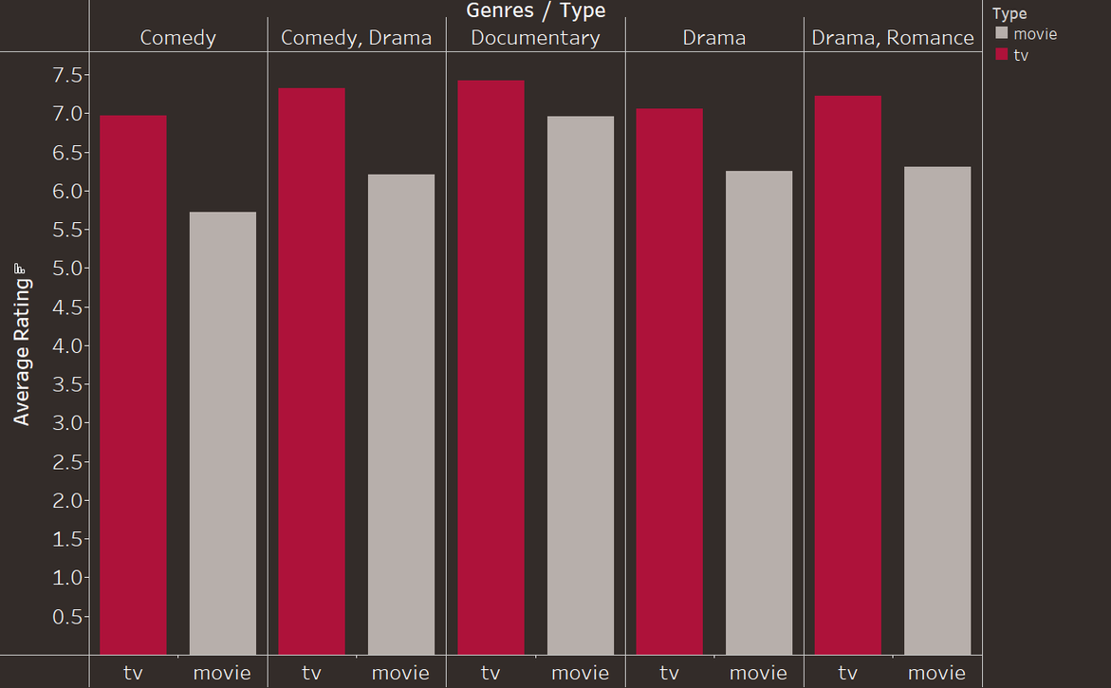
The turnout on TV was higher than movies for the Top 5 genres
  Comparison of the average ratings between TV shows and movies across the top 5 most popular genres.
  In every single genre, TV shows had higher average ratings than movies.
    In Comedy-Drama, TV shows average around 7.3, while movies are closer to 6.3.
    In Documentaries, TV shows are rated about 7.5, versus 6.9 for movies.

Slide 10



Pricing Strategy
The number of available series is very limited.
But they have the highest average ratings.
Therefore, we recommend increasing the number of series, either through purchasing or original production.
Based on a defined budget, expected subscriptions, and economic feasibility.
Focus on top 5 genres (e.g., Documentary, Drama, Comedy).

Slide 11

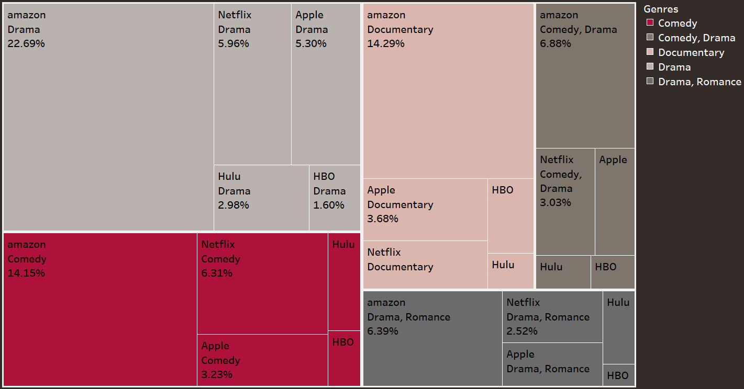
Genre distribution across platforms
Redundancy Alert: Netflix and Apple TV overlap
Drama and Comedy dominate the streaming space.
Netflix and Apple TV platforms offer nearly identical content
Content type (21% TV, 78% Movie)
Content volume (Apple: 15.7k | Netflix: 18.7K Netflix)

Slide 12


Redundant Strategy
Retain only one platform between Netflix and Apple TV
WHY?
To eliminate redundant content
Reduce licensing and platform costs
HOW?
Compare user preference, exclusive content, and cost-efficiency
Select the platform with better strategic value.

Slide 13
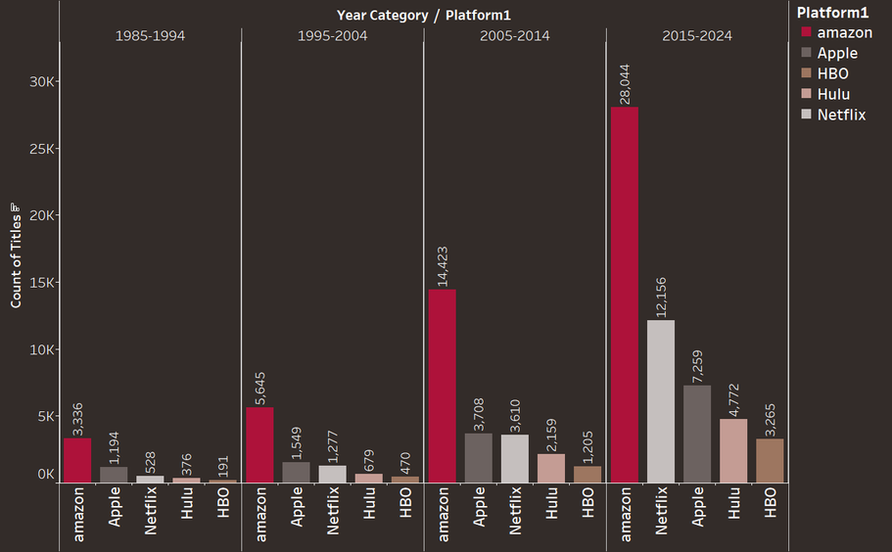
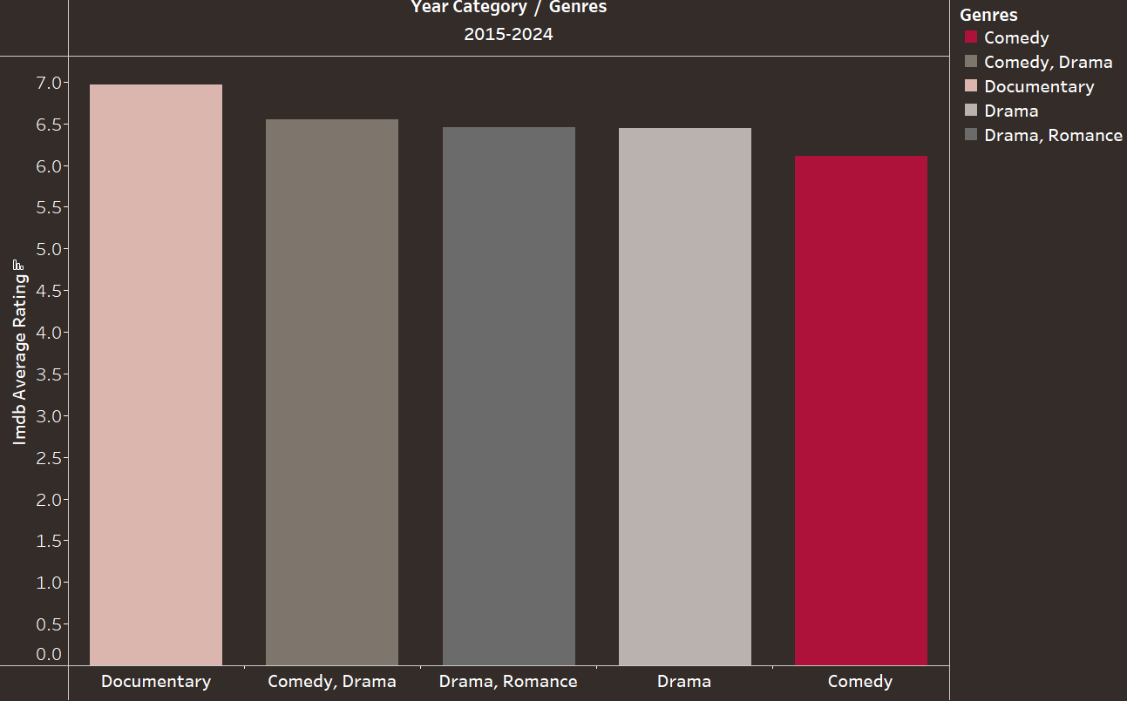
All platforms showed higher fresh content
  During 2015-2024, all platforms showed higher content releases.
At this period, top-rated genres are “documentary” and “comedy, drama”

Slide 14



Recommendation - related to release years
Continuously Update Content
Focus on the Highest-Rated Genres
Keep an Eye on Trends and Oscar-Awarded Movies

Slide 15
Countries Preferred Content
Countries | Top Rated Platform | Top Rated Genre | Top Rated Release Years
Top 5 Countries | HBO | Documentary | All years similar rating
Middle 5 Countries | Apple | Documentary | All release years have similar rating
Bottom 5 Countries | Apple | Documentary | Recent content

Slide 16





The Middle 5 Countries Have NO Data on HOB Max and Hulu Platforms!!!
New Zealand
Gibraltar
Poland
Thailand
Bahrain

Slide 17
About Platforms
Factors | Amazon Prime | Apple | Netflix | Hulu | HBO -Max
VPN Requirement | No - Available Globally | No - Available in most countries | No - Global access | Yes - Only for the U.S. | Yes - Limited to selected countries
Ads | No | No | No (on premium) | Yes | No
Subscriptions | ~200 million | ~25 million | ~260 million | ~50 million (mostly US) | ~ 95 million
Revenue | ~$ 12.7B | ~$ 1.4B | ~$ 37B | ~$ 11.2B | ~$ 10B

Slide 18

Recommendation for Hulu
  Expand global availability to reach wider audiences without requiring the use of VPNs.
  Remove advertisements from the platform to enhance user experience .
By using AWS services or extending your licensing rights as well.
If Hulu adopts this strategy, it could surpass other platforms in terms of profit, especially considering its large subscriber base.

Slide 19




Overall
Recommendations
Bring in famous actors or directors to promote both their movies and a related TV show during interviews or live events.
Create bundled plans featuring top movies and select TV episodes, giving users variety without oversaturating their viewing options.
Keep the movie list updated with seasonal picks like holiday specials, trending releases, or award-winning films.

Slide 20
Thank You
Do you have any questions?

